Slide 1

Plasma Donor ManagemenT SystEM COVID-19 Patients
Presented By:
Swathi Badicole |RamyaSree Modadugu |Smita Kulkarni

Slide 2



What we aim to do?
CHALLENGE
Under critical conditions, because of poor data management of donors & COVID patients, can lead to unnecessary delays which thereby impacts the patient’s recovery
PROPOSAL
We are aiming to design and implement an automated system that will alleviate this problem of handling COVID patients’ data in a hospital and plasma donor information
SOLUTION
Our database will felicitate accurate and quick data thereby matching the right plasma donor to the COVID patient. Our proposed database will help in connecting hospitals and plasma banks

Slide 3



How will we solve it?
HOSPITALS
COVID-19 PDMS
PLASMA BANKS
Hospitals treating COVID-19 patients records and shares the details with our company, which in turn saves this information securely in our databases
With our secure database system, we try to connect the right plasma donors to the patients and store this information in our database which can be accessed by both hospitals and plasma banks
Plasma banks collect the plasma from eligible donors and shares this information to our company and this is stored securely in our databases

Slide 4
Plasma Donor Eligibility Criteria
Verification on plasma donor eligibility is done by our company before the data is recorded to our PDMS securely. This ensures, the plasma that is received by the patient to be 100% beneficial.
Donors should be 18 years and older and weigh at least 120 lbs.
Overall good health
Potential donors must have had documented SARS-Cov2 infection or swab positivity
Donor should be symptom-free for at least 14 days before the donation date
Should meet standard blood donor eligibility requirements
Individuals who themselves were treated with plasma for their own Covid-19 illness are not allowed to donate blood samples including plasma for 3 months

Slide 5





Project Milestones
Database Initial Study
Database
Design
Implementation & Loading
Testing & Evaluation
Final Presentation
1-Nov-2020
16-Nov-2020
23-Nov-2020
30-Nov-2020
07-Dec-2020
Analyze situation
Define problems & Constraints
Define Objectives, Scope, Boundaries
Business Rules
Relationship mapping
Identify attributes
Create conceptual Design
DBMS selection
Logical & Physical Design
DBMS Installation
Schema Creation
Data Load
Testing & Evaluation
Final Demo & Presentation

Slide 6




Database design & modeling

Slide 7

Business Rules
One COVID patient belongs to one hospital
Each hospital has many rooms
Each Plasma transfusion can have multiple Billing
One hospital can have many COVID patients
Each room belongs to one hospital
Each Billing is related to one plasma transfusion
Each patient will have one blood group
Each COVID patient is admitted to one room
Each donor can do the plasma donation multiple times
Multiple patients will have the same blood group.
Each room can admit one patient at a time
Each donation is done by one donor at a time
Each doctor belongs to one hospital
Each billing belongs to one patient
Each donor will have one blood group
One hospital can have multiple doctors
Each patient can receive one plasma transfusion
Multiple donors will have the same blood group
Each patient can get treatment from one doctor
Plasma transfusion can be done for multiple patients
Each Plasma Bank can receive plasma from many donors
Each doctor can treat multiple patients
Each donation is related to one plasma bank
One donor can donate in many Plasma banks

Slide 8

Keys
ENTITY | PRIMARY KEY | FOREIGN KEY
HOSPITAL | HOSPITAL_ID | NA
DOCTOR | DOCTOR_ID | HOSPITAL_ID
ROOM | ROOM_ID | HOSPITAL_ID
PATIENT | PATIENT_ID | HOSPITAL_ID, DOCTOR_ID, ROOM_ID, BLOOD_GROUP_ID
PLASMA_BANK | PBANK_ID | NA
BILLING | BILLING_ID | PATIENT_ID, PLASMA_TRANS_ID
PLASMA_TRANSFUSION | PLASMA_TRANS_ID | PATIENT_ID, DONATION_ID, P_AVAIL_ID
DONOR | DONOR_ID | PBANK_ID, BLOOD_GROUP_ID
DONATION | DONATION_ID | DONOR_ID, PBANK_ID
BLOOD_GROUP | BLOOD_GROUP_ID | NA
PLASMA_AVAILABILITY | P_AVAIL_ID | DONATION_ID, PBANK_ID

Slide 9
PDMS Table Attributes
HOSPITAL
PLASMA_BANK
PATIENT
DONOR
DOCTOR
ROOM
DONATION
PLASMA_AVAILABILITY
PLASMA TRANSFUSION
HOSPITAL_ID
PBANK_ID
PATIENT_ID
PATIENT_ZIPCODE
DONOR_ID
DOCTOR_ID
ROOM_ID
DONATION_ID
P_AVAIL_ID
PLASMA_TRANS_ID
HOSPITAL_NAME
PBANK_NAME
PATIENT_FNAME
PATIENT_CONTACT
DONOR_FNAME
DOCTOR_FNAME
HOSPITAL_ID
DONATION_DATE
PBANK_ID
P_AVAIL_ID
HOSPITAL_EMAIL
PBANK_EMAIL
PATIENT_LNAME
PATIENT_BLD_PH
DONOR_LNAME
DOCTOR_LNAME
FLOOR
DONOR_ID
DONATION_ID
PATIENT_ID
HOSPITAL_STATE
PBANK_STATE
PATIENT_DOB
PATIENT_EMAIL
DONOR_AGE
DOCTOR_EMAILID
ROOM_TYPE
PBANK_ID
P_AVAIL_STATUS
PLASMA_TRANSFUSION_DATE
HOSPITAL_COUNTRY
PBANK_COUNTRY
PATIENT_GENDER
ROOM_ID
DONOR_GENDER
HOSPITAL_ID
HOSPITAL_CITY
PBANK_CITY
PATIENT_WEIGHT
DOCTOR_ID
DONOR_HMB
BILLING
HOSPITAL_ZIPCODE
PBANK_ZIPCODE
PATIENT_HMB
PLASMA_REQ
BLOOD_GROUP_ID
BILLING_ID
HOSPITAL_CONTACT
PBANK_CONTACT
HOSPITAL_ID
DONOR_CITY
BILLING_PRICE
HOSPITAL_WEBSITE
PBANK_WEBSITE
BLOOD_GROUP_ID
DONOR_STATE
BILLING_DESC
PATIENT_CITY
DONOR_COUNTRY
BILLING_DATE
PATIENT_STATE
DONOR_ZIPCODE
PLASMA_TRANS_ID
PATIENT_COUNTRY
DONOR_CONTACT
PATIENT_ID
BLOOD_GROUP_ID
PBANK_ID
BILL_PAID

Slide 10
Relationship Table
ENTITY | RELATIONSHIP | CONNECTIVITY | ENTITY
HOSPITAL | admits | 1:M | PATIENT
HOSPITAL | has | 1:M | ROOM
HOSPITAL | employs | 1:M | DOCTOR
PATIENT | pays | 1:M | BILLING
PATIENT | receives | 1:1 | PLASMA_TRANS
PLASMA_AVAILABILITY | is used for | 1:1 | PLASMA_TRANS
DONOR | donates | 1:M | DONATION
DONOR | belongs to | 1:1 | BLOOD GROUP
PATIENT | belongs to | 1:1 | BLOOD GROUP
PATIENT | is admitted to | 1:1 | ROOM
PATIENT | treated by | 1:1 | DOCTOR
BILLING | includes | 1:1 | PLASMA_TRANS
DOCTOR | treats | 1:M | PATIENT
DONATION | received by | 1:1 | DONOR
PATIENT | admitted to | 1:1 | HOSPITAL
BLOOD GROUP | includes | 1:M | PATIENT
BLOOD GROUP | includes | 1:M | DONOR
PLASMA_BANK | has | 1:M | PLASMA_AVAILABILITY
DONATION | has | 1:1 | PLASMA_AVAILABILITY
PLASMA_BANK | has | 1:M | DONATION
PLASMA_TRANSFUSION | received by | 1:M | PATIENT

Slide 11
ENTITY RELATIONSHIP DIAGRAM

Slide 12
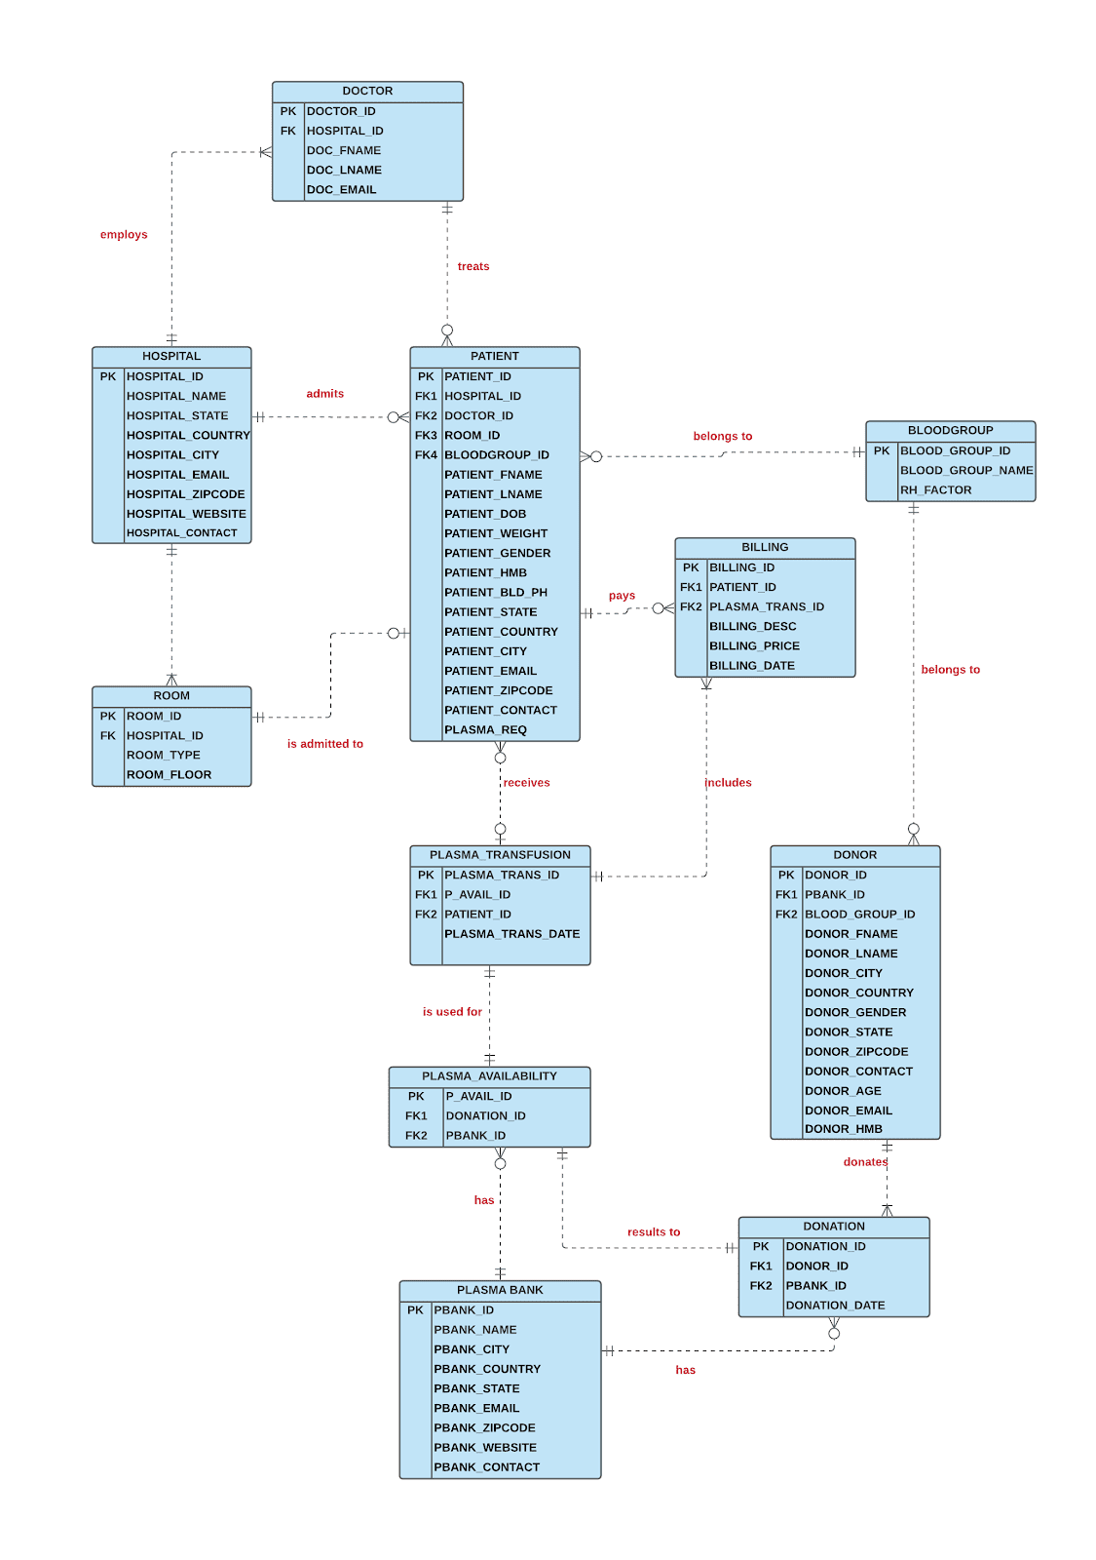
ERD

Slide 13
NORMALIZATION

Slide 14
DEPENDENCY DIAGRAMS – TABLES IN 3NF AND BCNF
Hospital
Hospital_ID
Hospital_Name
Hospital_Email
Hospital_City
Hospital_Country
Hospital_State
Hospital_Zipcode
Hospital_Contact
Hospital_Website
Plasma Bank
PBank_ID
PBank_Name
PBank_Email
PBank_City
PBank_Country
PBankl_State
PBank_Zipcode
PBank_Contact
PBank_Website
Patient
Patient_ID
Patient_Fname
Patient_Lname
Patient_City
Patient_Country
Patient_State
Patient_Zipcode
Patient_Contact
Patient_Gender
Patient_DOB
Patient_Weight
Blood_Group_ID
Patient_Hmb
Patient_Bld_PH
Hospital_ID
Doctor_ID
Room_ID
Doctor
Donation
Doctor_ID
Doctor_FName
Doctor_Email
Doctor_LName
Hospital_ID
Donation_ID
Donation_Date
Donor_ID
Pbank_ID

Slide 15
DEPENDENCY DIAGRAMS – TABLES IN 3NF AND BCNF
Billing
Billing_ID
Billing_Price
Billing_Desc
Billing_Date
Patient_ID
Plasma_Trans_ID
Plasma Transfusion
Blood Group
Plasma_Trans_ID
Plasma_Trans_Date
Patient_ID
P_Avail_ID
Blood_Group_ID
Blood_Group_Name
Donor
Donor_ID
Donor_Fname
Donor_Lname
Donor_Gender
Donor_Age
Donor_Email
Blood_Group_ID
Donor_Country
Donor_Zipcode
pBank_ID
Donor_Hmb
Donor_City
Donor_State
Donor_Contact
Room
Plasma Availability
Room_ID
Room_Type
Room_Floor
Hospital_ID
P_Avail_ID
Pbank_ID
Plasma_Avail
Donation_ID

Slide 16
IMPLEMENTATION & LOADING DATA

Slide 17

Triggers Created
Patient_Plasma_Req
Donation_After_Insert
Plasma_Transfusion_After_Insert
Patient’s table Plasma_Req attribute needs to be changed to ‘N’ soon after the Patient receives plasma transfusion. This will ensure the same patient is not considered for next plasma transfusion
An Entry in the Donation table needs to make a corresponding entry in Plasma_Availability table. This is required as each plasma donation is made available for patients' needs
Patient receives plasma, the corresponding record from Plasma_Availability table will be deleted. This is required as once the plasma donation is used for plasma transfusion it cannot be used again for another patient
DROP TRIGGER IF EXISTS `pdms`.`PATIENT_PLASMA_REQ`;
DELIMITER $$
USE `pdms`$$
CREATE DEFINER = CURRENT_USER TRIGGER `pdms`.`PATIENT_PLASMA_REQ`
AFTER INSERT ON `PLASMA_TRANSFUSION` FOR EACH ROW
BEGIN
UPDATE PATIENT
SET PLASMA_REQ= 'N'
WHERE PATIENT_ID=NEW.PATIENT_ID;
END$$
DELIMITER
DROP TRIGGER IF EXISTS `pdms`.`DONATION_AFTER_INSERT`;
DELIMITER $$
USE `pdms`$$
CREATE DEFINER = CURRENT_USER TRIGGER `pdms`.`DONATION_AFTER_INSERT` AFTER INSERT ON `DONATION` FOR EACH ROW
BEGIN
INSERT INTO PLASMA_AVAILABILITY (PBANK_ID,DONATION_ID,P_AVAIL_STATUS) VALUES (NEW.PBANK_ID, NEW.DONATION_ID,'Y’);
END$$
DELIMITER
DROP TRIGGER IF EXISTS `pdms`.`PLASMA_TRANSFUSION_AFTER_INSERT`;
DELIMITER $$
USE `pdms`$$
CREATE DEFINER = CURRENT_USER TRIGGER `pdms`.`PLASMA_TRANSFUSION_AFTER_INSERT` AFTER INSERT ON `PLASMA_TRANSFUSION` FOR EACH ROW
BEGIN
UPDATE PLASMA_AVAILABILITY
SET P_AVAIL_STATUS='N'
WHERE P_AVAIL_ID= NEW.P_AVAIL_ID;
END$$
DELIMITER

Slide 18

Procedures Created
Find_Plasma_Match
Get_nearby_plasma_banks
Get_overall_patient_details
To check for the blood group matching plasma’s, by retrieving the patient blood group and comparing against all the plasma donors and getting their respective donation status if it is available. Patient_id is the input parameter
To find the plasma banks available in nearby proximity from the patient city by passing the patient city as input parameter
Complete patient-related details like name, contact, plasma-transfusion, and corresponding plasma_bank details can be fetched by, passing patient_id, which can be used while billing or to access them easily
DROP PROCEDURE find_plasma_match;
DELIMITER $$
CREATE PROCEDURE find_plasma_match(iN PAT_ID INT)
BEGIN
SELECT PATIENT_ID, PATIENT_LNAME, PATIENT_CITY,
BLD_GROUP_NAME AS PATIENT_BLD_GRP,
PB.PBANK_NAME,DONATION.PBANK_ID,DONOR.DONOR_ID,PBANK_CON
TACT,PBANK_CITY,DONOR_LNAME, BLD_GROUP_NAME AS
DONOR_BLD_GRP, DONATION.DONATION_ID, P_AVAIL_STATUS
FROM PATIENT JOIN BLOOD_GROUP
ON PATIENT.BLD_GRP_ID = BLOOD_GROUP.BLD_GRP_ID
JOIN DONOR
ON BLOOD_GROUP.BLD_GRP_ID = DONOR.BLD_GRP_ID
JOIN DONATION
ON DONOR.DONOR_ID = DONATION.DONOR_ID
JOIN PLASMA_AVAILABILITY PA
ON DONATION.DONATION_ID = PA.DONATION_ID
JOIN PLASMA_BANK PB
ON PB.PBANK_ID=PA.PBANK_ID
WHERE P_AVAIL_STATUS = 'Y'
AND PATIENT.BLD_GRP_ID = DONOR.BLD_GRP_ID
AND PATIENT_ID = PAT_ID
AND PATIENT_CITY=PBANK_CITY;
END $$
DELIMITER
DROP PROCEDURE IF EXISTS get_nearby_plasma_banks;
DELIMITER $$
CREATE PROCEDURE get_nearby_plasma_banks (
IN PAT_CITY VARCHAR(50)
)
BEGIN
SELECT PLASMA_BANK.PBANK_ID, PBANK_NAME, PBANK_CITY,
PBANK_ZIPCODE, BLD_GROUP_NAME,
COUNT(BLD_GROUP_NAME) AS COUNT
FROM PLASMA_BANK JOIN PLASMA_AVAILABILITY
ON PLASMA_BANK.PBANK_ID =
PLASMA_AVAILABILITY.PBANK_ID
JOIN DONATION
ON DONATION.DONATION_ID =
PLASMA_AVAILABILITY.DONATION_ID
JOIN DONOR
ON DONOR.DONOR_ID = DONATION.DONOR_ID
JOIN BLOOD_GROUP
ON DONOR.BLD_GRP_ID = BLOOD_GROUP.BLD_GRP_ID
WHERE P_AVAIL_STATUS = 'Y' AND PBANK_CITY = PAT_CITY
GROUP BY
PLASMA_AVAILABILITY.PBANK_ID,DONOR.BLD_GRP_ID;
END $$
DELIMITER
DROP PROCEDURE get_overall_patient_details;
DELIMITER $$
CREATE PROCEDURE get_overall_patient_details(
IN PAT_ID INT
)
BEGIN
SELECT PATIENT.PATIENT_ID, CONCAT(PATIENT_FNAME,
PATIENT_LNAME) AS FULL_NAME, PATIENT_CONTACT,
HOSPITAL_ID PLASMA_TRANS_ID,
PBANK_ID, DATE(PLASMA_TRANS_DATE) AS TRANS_DATE,
ROOM_ID, BILLING_PRICE, BILL_PAID
FROM PATIENT JOIN PLASMA_TRANSFUSION
ON PATIENT.PATIENT_ID =
PLASMA_TRANSFUSION.PATIENT_ID
JOIN PLASMA_AVAILABILITY
ON PLASMA_TRANSFUSION.P_AVAIL_ID =
PLASMA_AVAILABILITY.P_AVAIL_ID
JOIN BILLING B
ON PATIENT.PATIENT_ID = B.PATIENT_ID
WHERE PATIENT.PATIENT_ID = PAT_ID;
END $$
DELIMITER

Slide 19
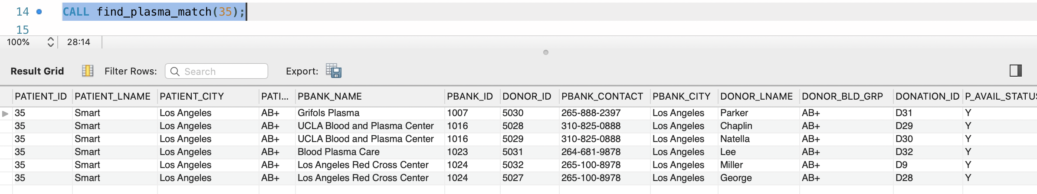
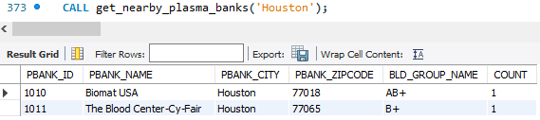
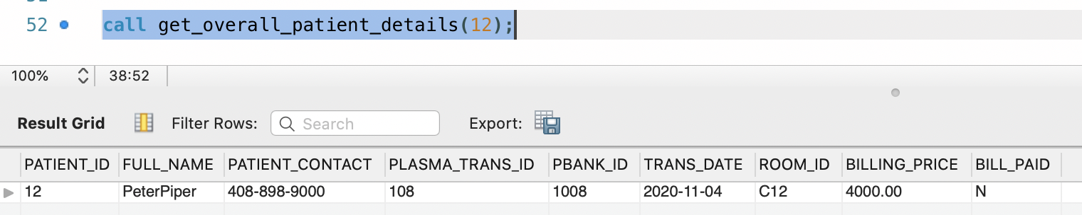
Scenarios & Output of Procedures
Scenario: Procedure to match the right plasma for a patient
Patient Names Karen Smart admitted in a Los Angeles hospital needs a plasma.
Find_plasma_match procedure can be used by passing the patient id to retrieve all the available matching plasmas.
Output
Scenario: Procedure to get nearby plasma banks
Few patients in Houston hospital needs plasma transfusion immediately. Following procedure Get_nearby_plasma_banks can be used to check the details of all plasma availability in nearby plasma banks.
Scenario: Procedure to get overall patient details
Patient Named Peter Piper wants to know if his Billing is closed
Get_overall_patient_details procedure can be used to check if patient’s payment is done.
Output
Output

Slide 20

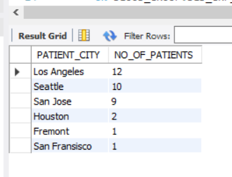
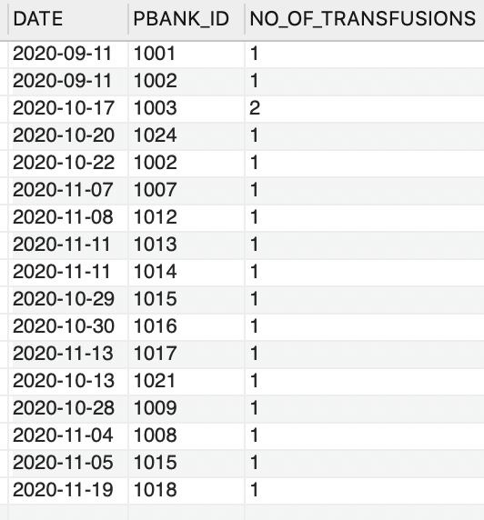
Views Created
Patients_Per_City
No_of_Transfusions
Provides the number of patients getting admitted in each city that require plasma, this would be helpful to identify highly impacted cities.
Helpful to get the overview of transfusions that happened with each plasma bank with respective transfusion dates
CREATE VIEW PATIENTS_PER_CITY AS
SELECT PATIENT_CITY, COUNT(patient_id) AS
NO_OF_PATIENTS
FROM PATIENT
group by PATIENT_CITY
ORDER BY NO_OF_PATIENTS DESC;
CREATE VIEW NO_OF_TRANSFUSIONS AS
SELECT DATE(PLASMA_TRANS_DATE) AS DATE, PBANK_ID,
COUNT(PLASMA_TRANS_ID) AS COUNT_PER_BANK
FROM PLASMA_TRANSFUSION JOIN PLASMA_AVAILABILITY
ON PLASMA_TRANSFUSION.P_AVAIL_ID =
PLASMA_AVAILABILITY.P_AVAIL_ID
GROUP BY PLASMA_TRANS_DATE, PBANK_ID;

Slide 21
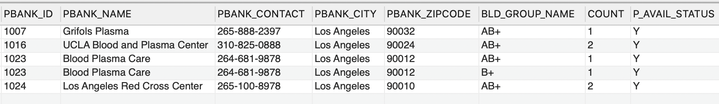
Views Created
LA_Available_Plasma
Helpful to check the availability of the number of plasma’s that are available for transfusion immediately at Los Angeles as the city has a greater number of patients as per current data
CREATE VIEW LA_AVAILABLE_PLASMAS AS
SELECT PLASMA_BANK.PBANK_ID, PBANK_NAME,, PBANK_CONTACT, PBANK_CITY, PBANK_ZIPCODE, BLD_GROUP_NAME, count(BLD_GROUP_NAME) AS
COUNT, P_AVAIL_STATUS
FROM BLOOD_GROUP JOIN DONOR
ON BLOOD_GROUP.BLD_GRP_ID = DONOR.BLD_GRP_ID
JOIN DONATION ON DONOR.DONOR_ID = DONATION.DONOR_ID
JOIN PLASMA_AVAILABILITY ON DONATION.DONATION_ID = PLASMA_AVAILABILITY.DONATION_ID
JOIN PLASMA_BANK ON DONATION.PBANK_ID = PLASMA_BANK.PBANK_ID WHERE P_AVAIL_STATUS = ‘Y’
AND PBANK_CITY = 'Los Angeles'
GROUP BY PBANK_CITY,BLD_GROUP_NAME
ORDER BY PLASMA_BANK.PBANK_ID;

Slide 22
REPORTS

Slide 23
Reports Part I

Slide 24
Reports Part II

Slide 25
Security Checks
Each user can be a part of the following four roles that are created for PDMS.: pdms_read, pdms_write, pdms_hospital, pdms_plasmabank
Hospital user will not have written access to plasma bank related tables and will not be able to access donor personal information.
Similarly, plasma bank user will not have access to patient’s personal information and will only have read permissions on Hospital tables.
Security Privileges
User Account Management
Access Control
MySQL Enterprise Firewall
This will be used to block database attacks such as an SQL Injection and will guard against cyber security threats by providing real-time protection against database specific attacks
We will be restricting physical and remote access. We will monitor and remove inactive users; password management would be essential.

Slide 26

Project References & Links
Project Report
PDMS SQL Data Load File
https://www.bloodassurance.org/about-plasma-donation
https://www.mysql.com/products/enterprise/firewall.html
https://www.mysqltutorial.org/mysql-roles/
https://dev.mysql.com/doc/refman/8.0/en/security.html
https://www.fda.gov/media/141479/download#:~:text=The%20blood%20from%20people%20who,causes%20COVID%2D19.

Slide 27
THANK YOU

